Slide 1

Fantastic Five​
Interactive Tool Promoting Sustainable Development Goal (SDG) 12:​
Responsible Consumption and Production​
Zainab, Callum, Zaid, Ibrahim, Ebenezer​

Slide 2
Contents
Introduction
3
Goal and Alignment to SDG 12
4
Project Concept
5
Features of the interactive map
6
Originality and Interactivity
Collaboration
7
8
User-friendly and accesibility
9
Design & Visualisation
10
SDG Coverage
11
Future Plans/ Enhancement
12
Timelines
13

Slide 3
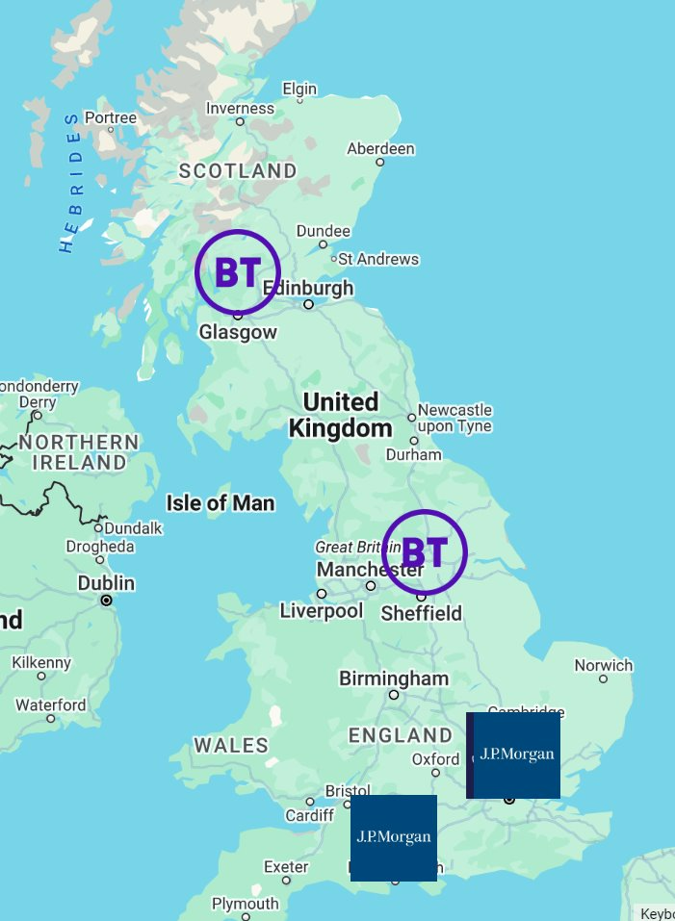
Introduction
Our project focuses on creating an interactive tool (A web map) to raise awareness about SDG 12 (Responsible Consumption and Production). It highlights workplace contributions to sustainability while engaging users with interactive content.​
​
Why SDG 12?​
SDG 12 addresses the urgent need for reducing waste, promoting sustainable practices, and minimising environmental impact.​
It is critical for fostering global environmental responsibility, particularly in industries like finance, telecoms, and beyond.​
​
How we address SDG 12​
The tool showcases sustainability initiatives from JP Morgan, BT Group, and Rokos Capital Management, emphasising real-world examples of responsible consumption and production.​
​

Slide 4
Goal and Alignment to SDG 12​
The Goal​
We aimed to build our website to bring awareness about SDG 12 importance, its challenges and actionable solutions through a visually engaging and educational tool.
How the Interactive Map Aligns with This Goal​
The map allows users to:​
Dive into sustainability initiatives by region.​
Learn through text and quizzes​

Slide 5

Project Concept​
Key Features: (Interactive Learning for impact)
Small Actions as Positive Tipping Points​
​
Quizzes to test and expand knowledge of sustainability​
Real-world examples: Company-specific sustainability practices​
Community engagement: Voting on impactful initiatives to encourage resognition of impactful efforts
By engaging with features such as learning modules, quiz, and voting, users take small but meaningful steps that contribute to broader awareness. These small actions act as "positive tipping points", creating cultural shifts in organisations and beyond.​
Definition
A tipping point is "a small change that makes a big difference to a system."​

Slide 6
Features of the interactive map​
Feature​ | Purpose​ | Impact​
Interactive Quiz​ | Test and expand knowledge of sustainability.​ | Increases awareness and understanding of responsible consumption practices.​
Company Initiatives​ | Highlight sustainability actions at workplaces.​ | Drives engagement with real-world examples and drives recognition.​
Each feature of the tool is designed to showcase and engage with company-specific initiatives, creating positive tipping points for sustainability: ​
Users explore real-world examples of responsible consumption and production at JP Morgan, BT Group, and Rokos Capital Management. ​
Interactions like the quiz and voting allow users to reflect on these initiatives and contribute to raising awareness.

Slide 7


Originality and Engagment
Our website stands out for its dynamic interactivity :
Explore Sustainable initiatives
Knowledge Testing
Users click on map segments to explore sustainability initiatives specific to JP Morgan, BT Group, and Rokos Capital Management.​
Quizzes test understanding and provide instant feedback, reinforcing knowledge about responsible consumption and production.​

Slide 8
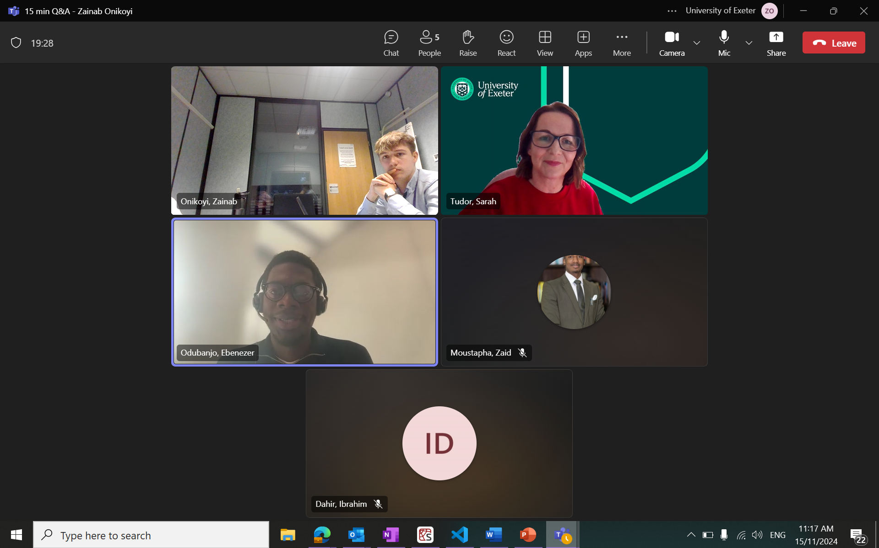
Collaboration
Effective Teamwork:
Regular Communication: We held Microsoft Teams meetings twice a week to review progress, share feedback, and ensure alignment​
Ongoing Collaboration: Team members stayed connected through calls and messages to address challenges and provide updates​
Roles and Contributions
Team Leader: Managed forms, organised meetings with advisors, and coordinated overall project efforts.​
Project Strategist: Created a comprehensive rationale, ensured project met requirements specified, and designed external communications.
Developers (2): Collaborated closely to implement the interactive map's features and met regularly with the toolkit creator.​
Toolkit Creator: Developed the supporting toolkit, ensuring it aligned with the tool and project goals.​
Toolkit contents:
The toolkit is designed to complement the web application, including:​
User Guide: Step-by-step instructions for navigating the map and its features.​
Awareness Resources: Additional materials to deepen understanding of SDG 12.
Implementation Tips: Suggestions for promoting the map within workplaces and other contexts.

Slide 9
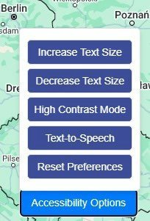
User-friendly and Accessibility
The tool utilises the Google Maps API, enabling an interactive and visually engaging experience​
This technology ensures the resource is scalable and can accommodate a growing number of users and locations seamlessly
Inclusivity and Accessibility Features
Clear Visual Design: Easy-to-navigate interface suitable for diverse tech skill levels.​
Multi-Device Compatibility: Accessible on desktops, tablets, and mobile devices.​
Text-to-Speech Functionality: Ensures accessibility for visually impaired users.​
High-Contrast Modes: Enhances visibility for users with visual impairments.​
Adjustable Text Size: Accommodates users with different vision needs.
Scalability for Wider Impact
The resource can easily integrate additional locations, initiatives, and features to remain relevant as sustainability efforts evolve. ​

Slide 10
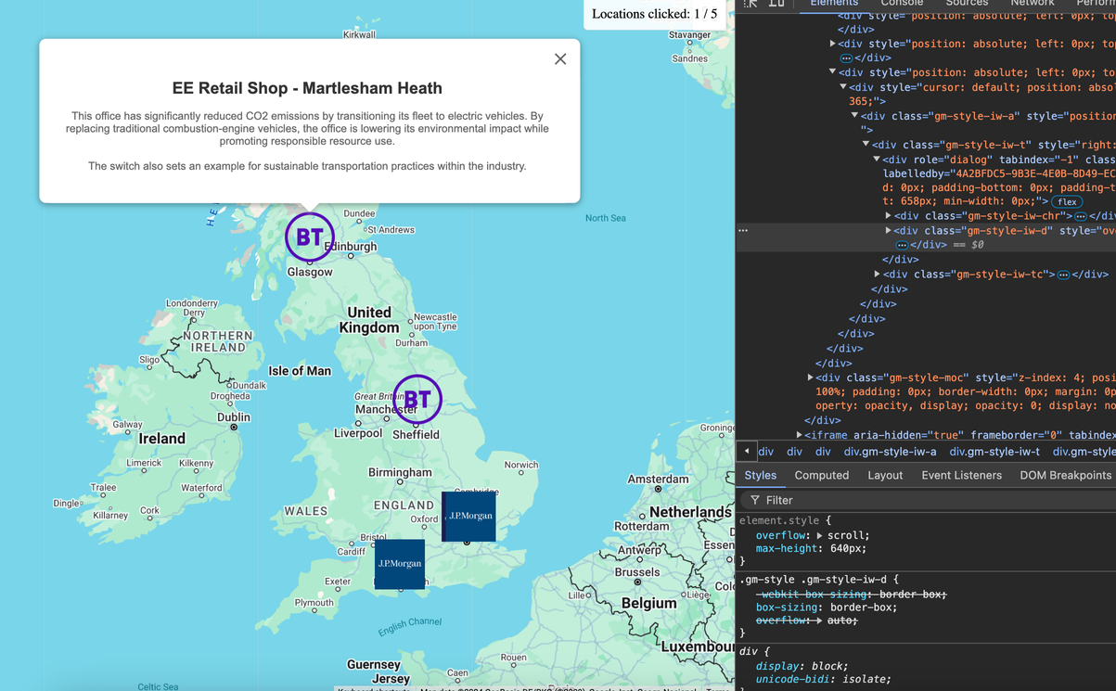
Creating a New Point on the Map
Steps to Add a New Point on the Map
Edit Code: Access the project’s code to make the necessary changes.
Add Office Name: Include the name of the office associated with the new map point.
Add SDG Information: Provide details about the office’s contribution to relevant SDGs (e.g., SDG 12).
Specify Map Position: Add latitude and longitude coordinates for the location on the map.
Include a Logo: Upload a representative logo of the office or organization to visually identify the point.
Current Workflow
Changes must be made by pulling the project from GitHub, editing the code, and creating a pull request.
Once the pull request is reviewed and accepted, the changes go live, and the new point is added to the interactive map.
This workflow allows anyone with access to the GitHub repository to suggest additions or edits to the map. It ensures a collaborative approach to maintaining and expanding the tool.

Slide 11
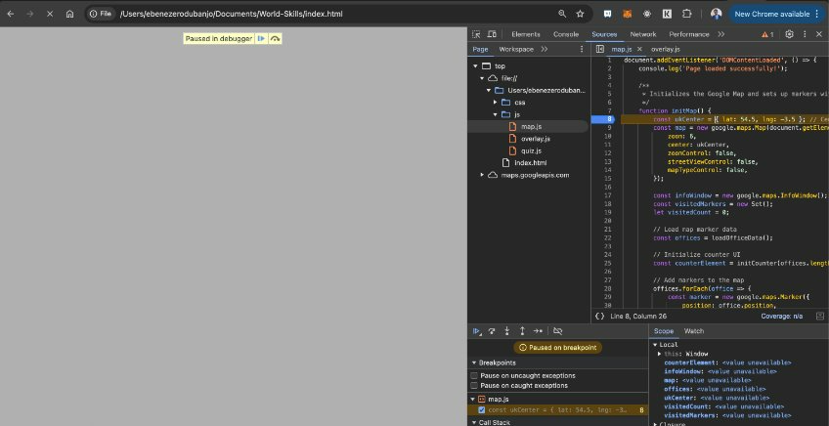
Design & Visualisation
Visual Appeal​
Color-Coded Map Segments: Highlight different regions and their contributions to SDG 12, making information easy to navigate.​
​- Engaging language​
The text and language are designed to be clear, concise, and accessible for a diverse audience.​
Key sustainability concepts are explained in relatable terms to foster understanding and connection.​
Tone: Encouraging and action-oriented to inspire users to participate in sustainability efforts.​
"Positive tipping points in one system can enable similar impacts in another."​
This concept underpins our project​

Slide 12
SDG Coverage
The interactive tool raises awareness about responsible consumption and production, emphasising the need to minimize waste, use resources efficiently, and adopt sustainable practices.​
By showcasing real-world examples, the map connects users to tangible actions that contribute to SDG 12.​
​
SDG 12 Critical Tipping Point:​
Responsible consumption and production are key tipping points in combating environmental degradation.​
By transforming consumption habits and production methods, organisations and individuals can trigger positive systemic changes:​
Reduced pollution and waste.​
Sustainable use of natural resources.​
Enhanced awareness of environmental impacts.​
The map visually represents this transformation, encouraging users to take small steps that collectively lead to broader cultural shifts in sustainability.​

Slide 13
Future Plans/ Enhancement​
Future Potential​
Although the resource effectively meets its awareness-raising goals, further development could greatly enhance its impact: ​
Detailed visuals: Improved animations to make the damaged-to-healthy transformation more immersive.​
Expanded voting system: Users could rank initiatives or suggest enhancements for workplace sustainability.​
Deeper Interactivity: Expanding features such as regional customisations and multilingual support. ​
Gamified experiences: Mini-games or challenges that deepen user engagement while emphasising SDG principles.​
​
By blending current and future features, the map maintains its unique appeal and has the potential to create even greater impact in raising awareness about SDG 12 also reinforcement positive tipping points, inspiring users to take meaningful action toward sustainability.​

Slide 14
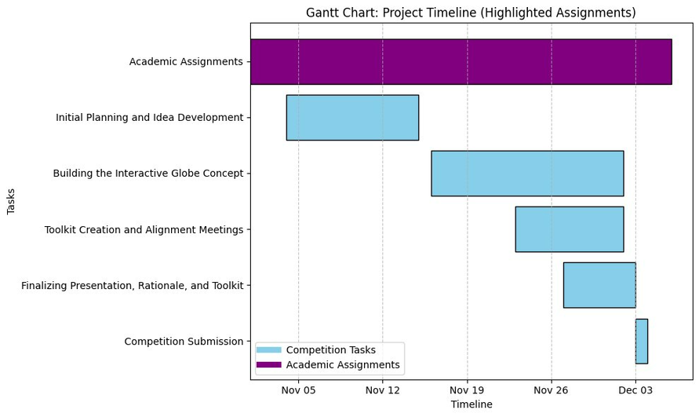
Timelines
Effective Team Coordination​
Biweekly Meetings: Regular Microsoft Teams meetings were held twice a week to review progress and set short-term goals.​
Task Delegation: Each team member focused on their assigned role to ensure steady progress, minimising overlap and delays.​
Clear Communication: Continuous updates via calls and messages helped address challenges promptly.​
​
Constraints and Challenges​
University Commitments: Balancing the project with academic assignments required careful time management.​
Professional Responsibilities: Team members contributed to the project while managing demanding job roles at JP Morgan, BT Group, and Rokos Capital Management.​
Personal Obligations: Scheduling and contributing to the project alongside personal responsibilities added complexity but was addressed through flexible collaboration.​

Slide 15
References
Global Tipping Points Website
1
BT Group Manifesto Strategy
4
BT Sustainability
5
Energy Saving Stories- Intranet- BT
7
ESG at RCM- Intranet- Rokos Capital Management
8
JP Morgan Solar Panels
9
JP Morgan ESG- Intranet- JP Morgan
10

Slide 16
Thank you

